Slide 1

Big Data and Hadoop Framework
8/10/2023

Slide 2
Agenda
Big Data Challenges
Hadoop Framework
HDFS (Hadoop Distributed File System)
Map Reduce Programming Concept
Demo Hadoop and Map Reduce Programming concept
8/10/2023

Slide 3
Big Data Challenges
A new paradigm is born as Data-intensive scientific discovery (DISD), also known as Big Data problems.
  Data capture
  Data storage
  Data analysis
  Data visualization
8/10/2023

Slide 4
Big Data in five domains
Health care
Public sector administration
Retail Transaction Data
Global manufacturing
Personal location data
James Manyika, Michael Chui, Brad Brown, Jacques Bughin, Richard Dobbs, Charles Roxburgh, Angela Hung Byers, Big data: The Next Frontier for Innovation, Competition, and Productivity, McKinsey Global Institute, 2012.
8/10/2023

Slide 5
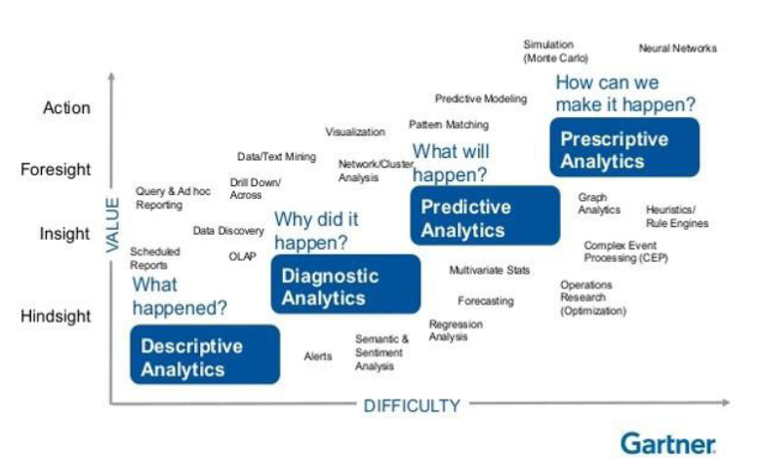
Goals of Big Data Analytics
8/10/2023

Slide 6
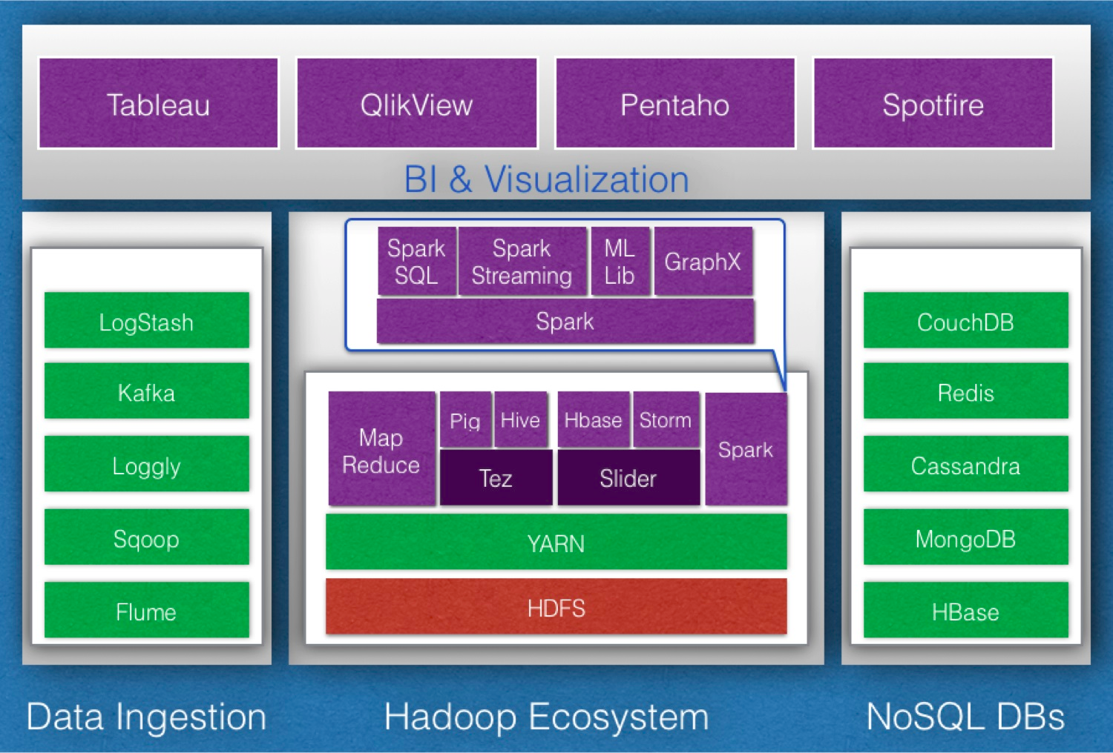
Big Data Analytics: Open Source Solutions
8/10/2023

Slide 7
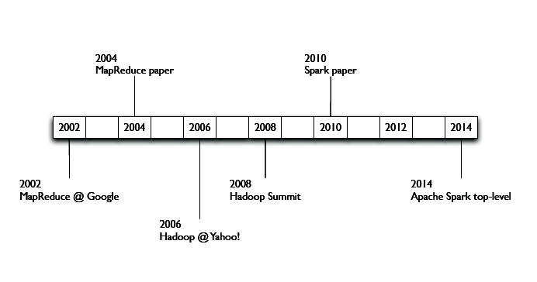
A Brief History
8/10/2023

Slide 8
Hadoop
Existing tools were not designed to handle such large
Amounts of data
"The Apache Hadoop project develops open-source
software for reliable, scalable, distributed computing."
-http://hadoop.apache.org
Process Big Data on clusters of commodity hardware
Vibrant open-source community
Many products and tools reside on top of Hadoop
8/10/2023

Slide 9

8/10/2023

Slide 10
History of Hadoop
Started as a sub-project of Apache Nutch
Nutch’s job is to index the web and expose it for searching
Open Source alternative to Google
Started by Doug Cutting
-In 2004 Google publishes Google File System (GFS) and MapReduce
framework papers
-2005, Doug Cutting and Nutch team implemented Google’s frameworks
in Nutch
-In 2006 Yahoo! hires Doug Cutting to work on Hadoop with a dedicated
team
-In 2008 Hadoop became Apache Top Level Project
– http://hadoop.apache.org
8/10/2023

Slide 11
Naming Conventions
Doug Cutting drew inspiration from his
Family
Lucene: Doug’s wife’s middle name
Nutch: A word for "meal" that his son used as a toddler
Hadoop: Yellow stuffed elephant named by his son
8/10/2023

Slide 12
Hadoop Current Status
April 1, 2016 marked the 10-year anniversary of the first Hadoop code release.
The vast majority of Fortune 500 companies are using Hadoop in production
Global Hadoop market was valued at $1.5 billion in 2012, and is expected to grow at a CAGR of 58.2% during 2013 to 2020 to reach $50.2 billion by 2020.
Hadoop Spark, a successor system that is more powerful and flexible than Hadoop MapReduce
Spark is intended to enhance, not replace, the Hadoop stack.
Recent trend in big data is processing big data in cloud computing environments.
Real time analysis(Business Intelligence)
http://searchdatamanagement.techtarget.com/news/4500272078/Co-creator-Cutting-assesses-Hadoop-future-present-and-past?utm_medium=EM&asrc=EM_NLN_53090788&utm_campaign=20160204_Hadoop%20at%2010:%20Q&A%20with%20co-creator%20Doug%20Cutting_jbiscobing&utm_source=NLN&track=NL-1816&ad=905761&src=905761
https://www.alliedmarketresearch.com/hadoop-market
https://www.dezyre.com/article/hadoop-mapreduce-vs-apache-spark-who-wins-the-battle/83
https://databricks.com/blog/2014/01/21/spark-and-hadoop.html
8/10/2023

Slide 13
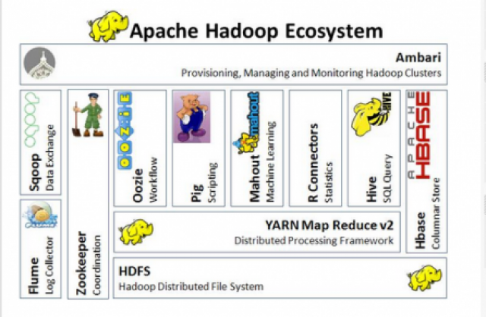
8/10/2023
Source: https://opensource.com/life/14/8/intro-apache-hadoop-big-data

Slide 14
Hadoop: Assumptions
• Hardware will fail.
• Processing will be run in batches. Thus there is an emphasis on high throughput as opposed to low latency.
• Applications that run on HDFS have large data sets. A typical file in HDFS is gigabytes to terabytes in size.
• It should provide high aggregate data bandwidth and scale to hundreds of nodes in a single cluster. It should support tens of millions of files in a single instance.
• Applications need a write-once-read-many access model.
• Moving Computation is Cheaper than Moving Data.
• Portability is important.
8/10/2023

Slide 15
Hadoop Distribution
• MapR Distribution
• Hortonworks Data Platform (HDP)
• Apache BigTop Distribution
• Greenplum HD Data Computing Appliance
• Cloudera Distribution for Hadoop (CDH)
– http://www.cloudera.com/hadoop
– 100% open-source and Integrates majority of popular Hadoop Products like: HDFS, MapReduce, HBase, Hive, Mahout, Oozie, Pig, Sqoop, Whirr, Zookeeper, Flume
8/10/2023

Slide 16
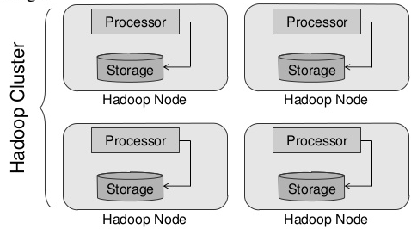
Hadoop Cluster
A set of “cheap” commodity hardware.
Networked Together
Reside in the same location
  Set of server in a set of racks in a data center
8/10/2023

Slide 17
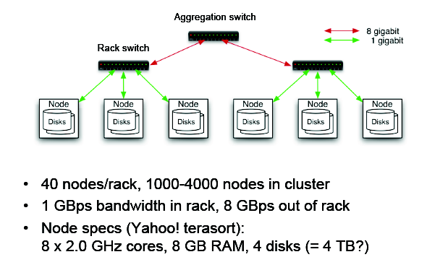
Typical Hadoop Cluster
8/10/2023

Slide 18

Typical Hadoop Cluster

Slide 19
The Apache Hadoop framework - Modules
Hadoop Common: contains libraries and utilities needed by other Hadoop modules
Hadoop Distributed File System (HDFS): a distributed file-system that stores data on the commodity machines, providing very high aggregate bandwidth across the cluster
Hadoop YARN: a resource-management platform responsible for managing compute resources in clusters and using them for scheduling of users' applications
Hadoop MapReduce: a programming model for large scale data processing
8/10/2023

Slide 20
HDFS Architecture
NameNode
  Record attributes like permissions, modification and access times, namespace and disk space quotas.
  NameNode keeps the entire namespace image in RAM
  The file content is split into large blocks (typically 128 megabytes, but user selectable file-by-file)
  Each block of the file is independently replicated at multiple DataNodes (typically three, but user selectable file-by-file).
  The NameNode maintains the namespace tree and the mapping of blocks to DataNodes.
  NameNode keeps the entire namespace image in RAM
Image, Journal, and checkpoints
8/10/2023

Slide 21
HDFS Architecture (Continue…)
DataNodes
  Each block replica on a DataNode is represented by two files in the local native filesystem.
  The first file contains the data itself and the second file records the block's metadata including checksums for the data and the generation stamp.
CheckpointNode
BackupNode
8/10/2023

Slide 22
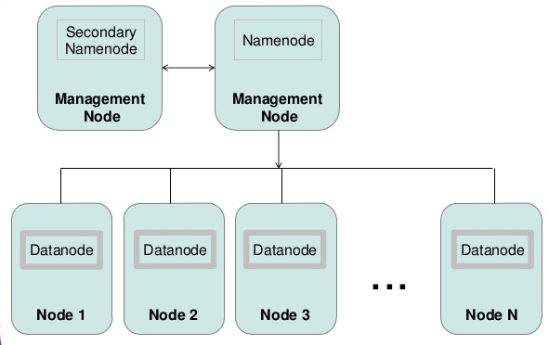
HDFS Continue...
HDFS is a block-structured file system (default 128 MB)
HDFS Daemons
8/10/2023

Slide 23
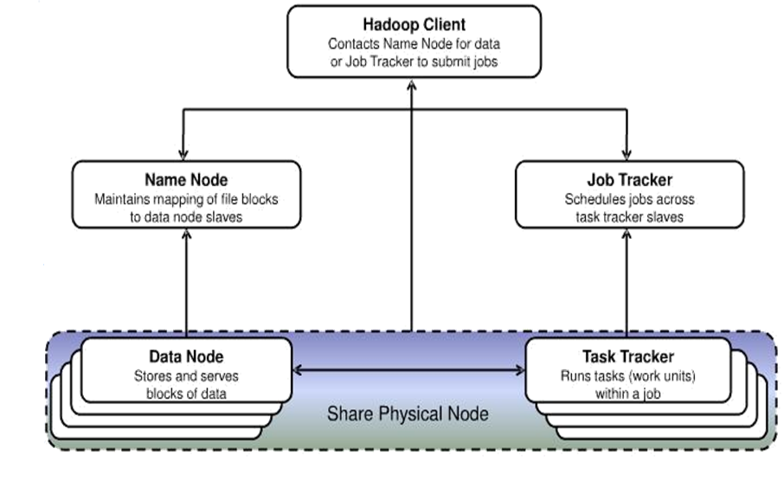
Hadoop high-level architecture
8/10/2023

Slide 24
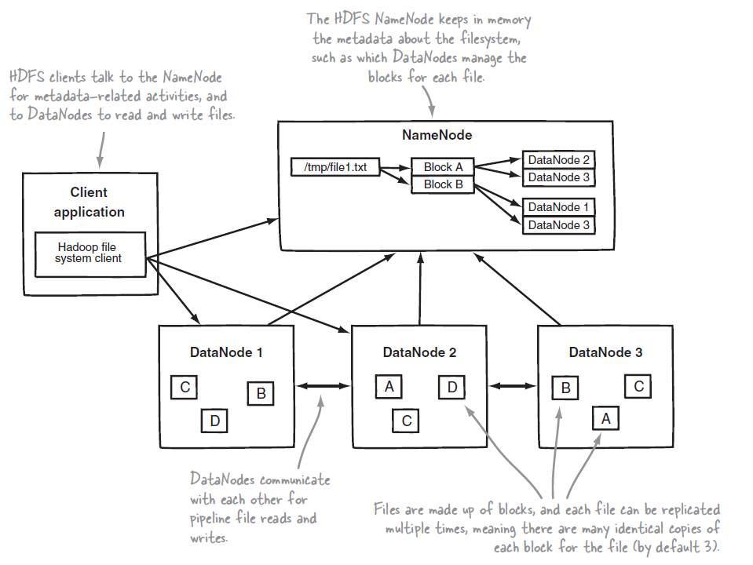
HDFS Architecture (Continue...)
8/10/2023

Slide 25
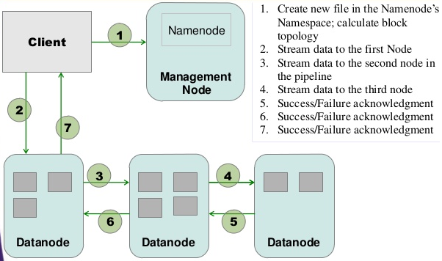
HDFS Write
8/10/2023

Slide 26
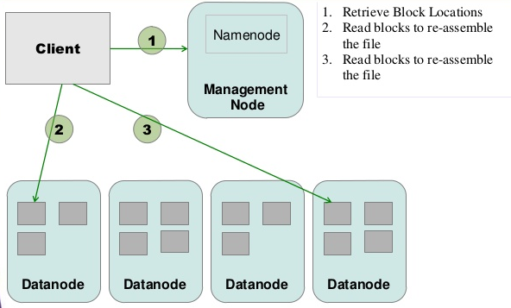
HDFS Read
8/10/2023

Slide 27
start-all.sh
jaiprakash@jaiprakash-HP-ProBook-4440s:/$start-all.sh
jaiprakash@jaiprakash-HP-ProBook-4440s:/$ jps
3538 SecondaryNameNode
3381 DataNode
7240 Jps
3786 TaskTracker
3629 JobTracker
3231 NameNode
8/10/2023

Slide 28
Hadoop Web Interfaces
Hadoop comes with several web interfaces which are by
default available at these locations:
http://localhost:9870/dfshealth.html#tab-overview
– web UI of the NameNode daemon
http://localhost:8088/cluster
– These web interfaces provide concise information about
what’s happening in Hadoop cluster
8/10/2023

Slide 29
Hadoop 2.x Features over 1.x
Allows to work in MR as well as other distributed computing models like Spark, Hama, Giraph, Message Passing Interface) MPI & HBase coprocessors.
YARN (Yet Another Resource Negotiator) does cluster resource management and processing is done using different processing models.
Has better scalability. Scalable up to 10000 nodes per cluster
Works on concepts of containers. Using containers can run generic tasks.
Multiple Namenode servers manage multiple namespace
Has feature to overcome SPOF with a standby Namenode and in case of Namenode failure, it is configured for automatic recovery.
MR API requires additional files for a program written in Hadoop1x to execute in Hadoop2x.
Can serve as a platform for a wide variety of data analytics-possible to run event processing, streaming and real time operations.
The Hadoop stack – Hive, Pig, HBase etc. are all equipped to handle Namenode failure.
Added support for Microsoft windows
8/10/2023

Slide 30
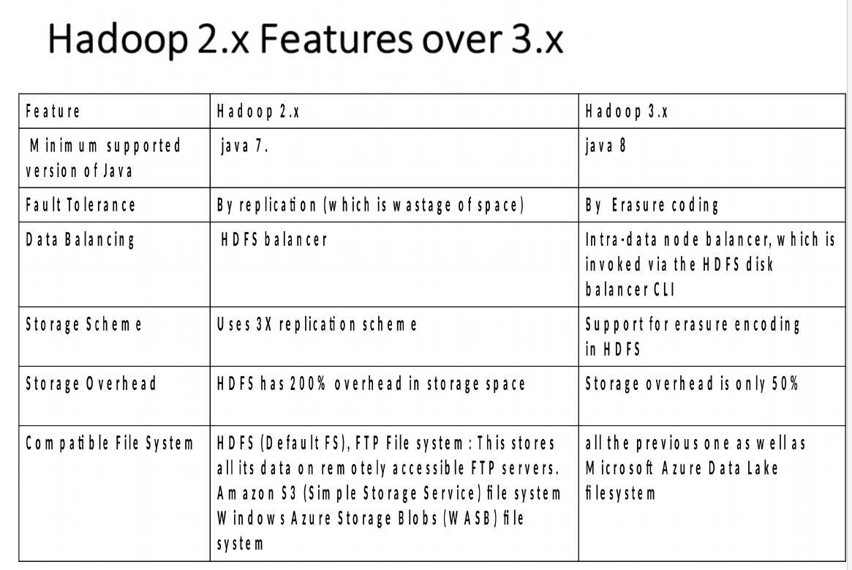

Slide 31
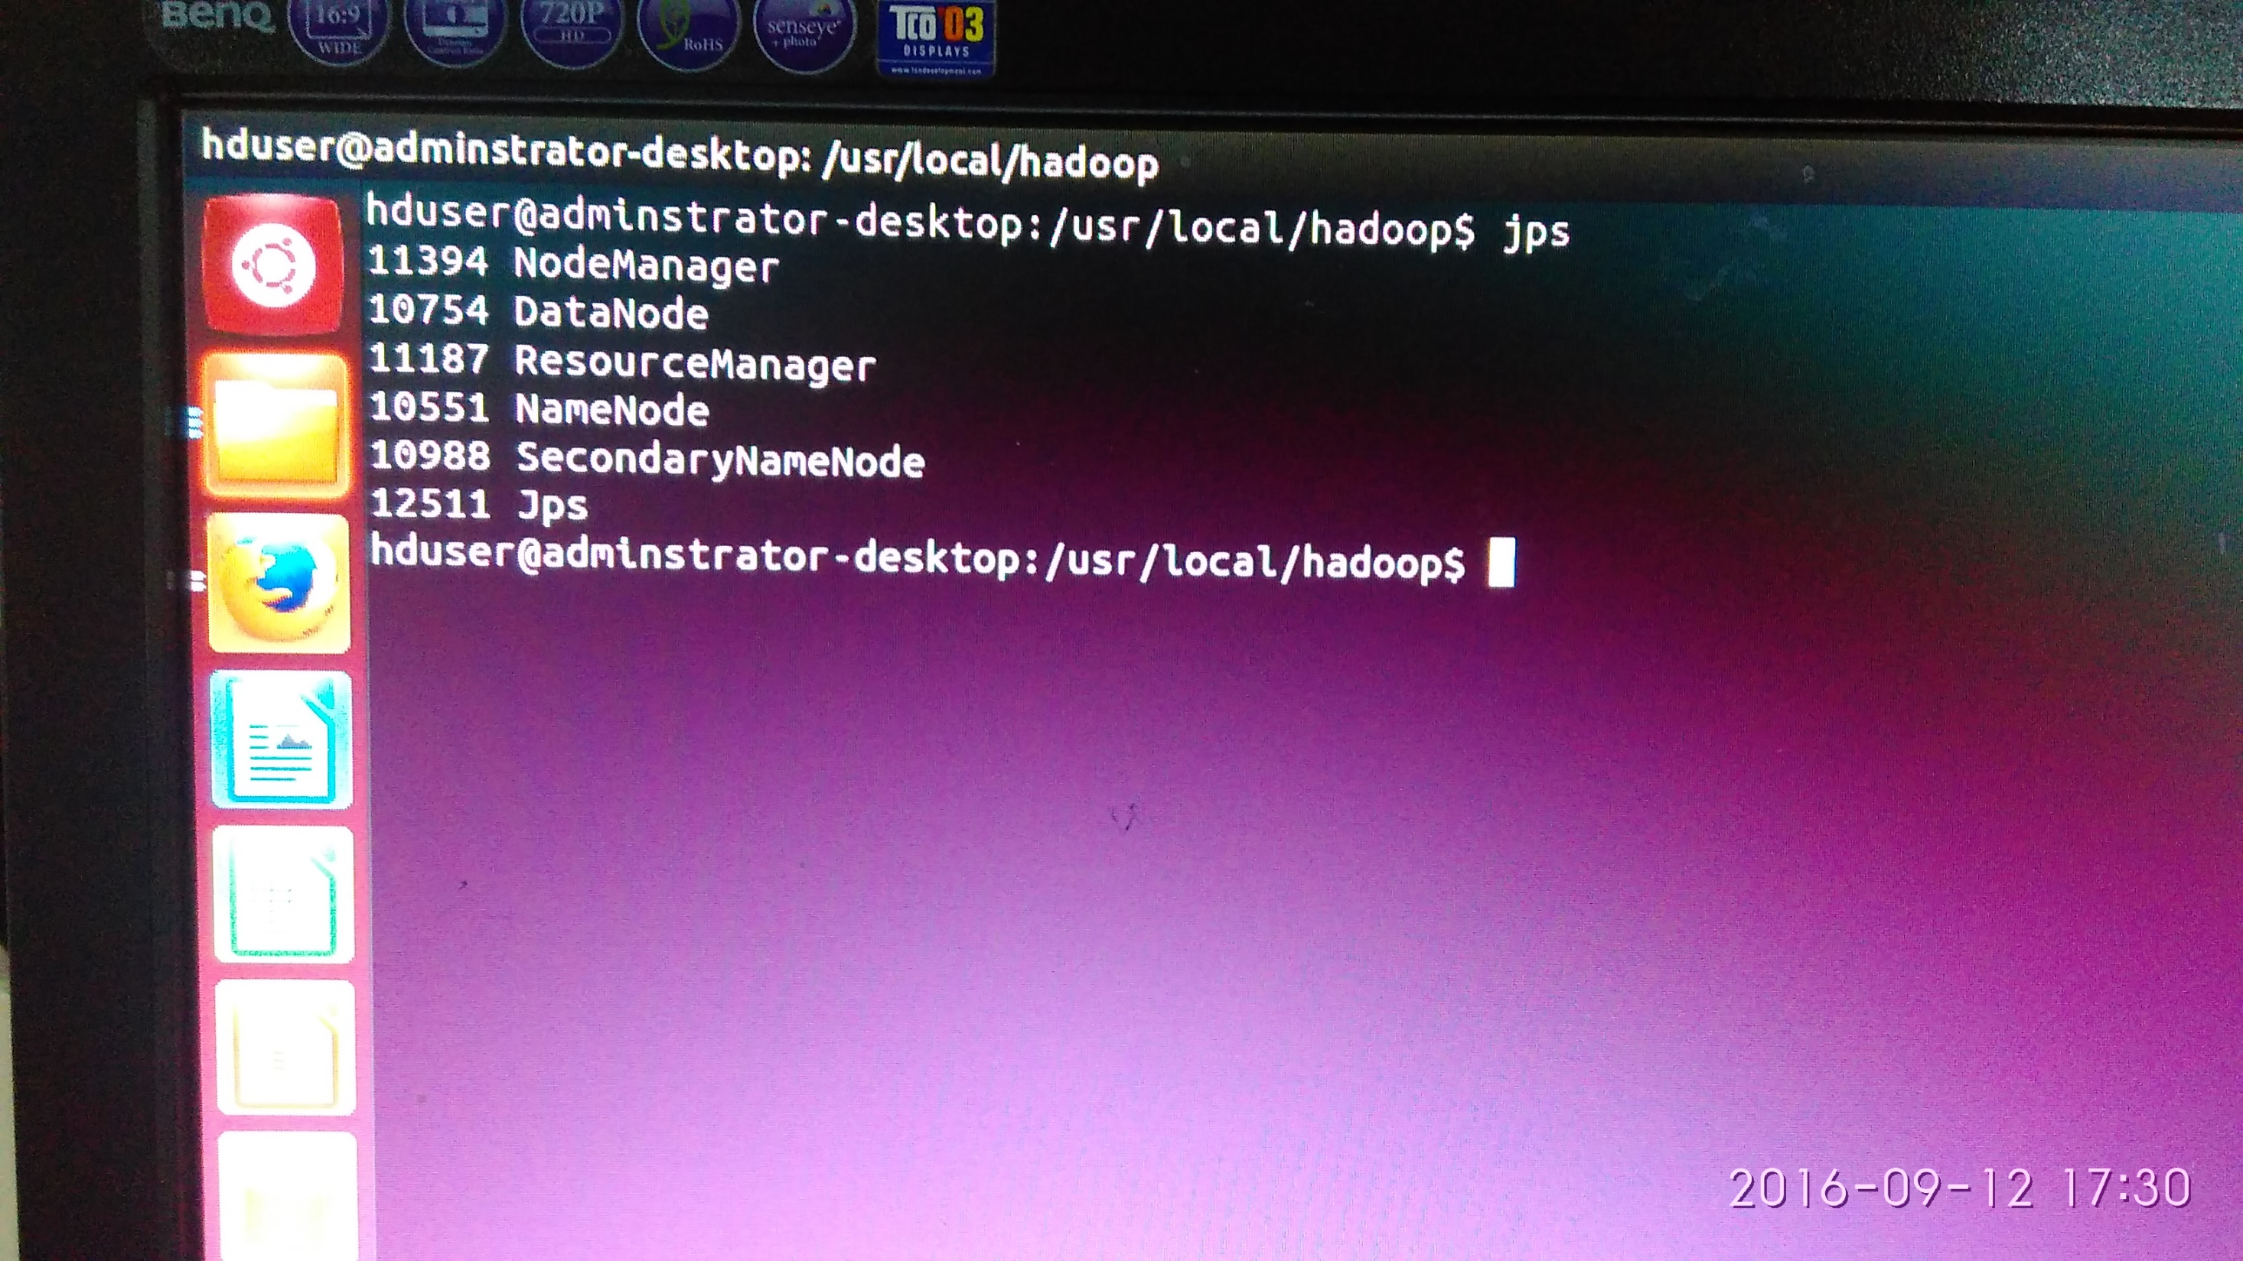
8/10/2023

Slide 32
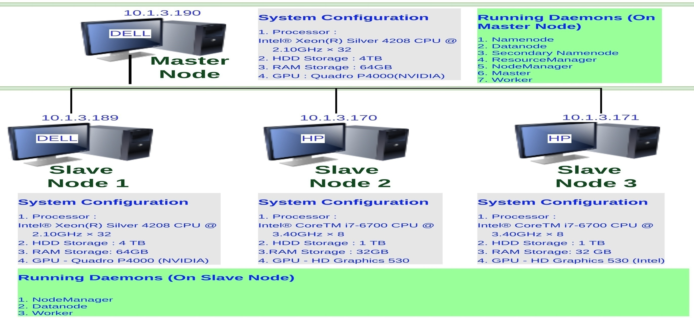
Hadoop and Spark Cluster Configuration – Cluster of SMP Nodes- ISRO Respond Project

Slide 33
Shell Commands
Interact with FileSystem by executing shell like commands
Usage: $hdfs dfs -<command> -<option>
  Example $hadoop dfs -ls /
Most commands behave like UNIX commands
  ls, cat, du, etc..
Supports HDFS specific operations
  Ex: changing replication
List supported commands
  $ hadoop dfs -help
Display detailed help for a command
  $ hadoop dfs -help <command_name>
8/10/2023

Slide 34
Shell Commands (Continue...)
Print the Hadoop version
  hadoop version
List the contents of the root directory in HDFS
  hadoop fs -ls /
Report the amount of space used and available on currently mounted files system
  hadoop fs -du hdfs:/
Count the number of directories, files and bytes under the paths that match the specified file pattern
  hadoop fs -count hdfs:/
Run a DFS file system checking utility
  hadoop fsck – /
Run a cluster balancing utility
  hadoop balancer
8/10/2023

Slide 35
Shell Commands (Continue...)
Create a new directory named “hadoop” below the /user/NIM directory in HDFS. /user/NIM is your home directory in HDFS.
  hadoop fs -mkdir /user/NIM/hadoop
Add a TotalWords text file from the local directory named “jaiprakash” to the new directory you created in HDFS during the previous step.
  hadoop fs -put /home/jaiprakash/sample.txt /user/training/hadoop
List the contents of this new directory in HDFS.
  hadoop fs -ls /user/NIM/hadoop
Add the entire local directory called “retail” to the /user/NIM/hadoop directory in HDFS.
  hadoop fs -put /home/jaiprakash/retail /user/NIM/hadoop
Since /user/NIM is your home directory in HDFS, any command that does not have an absolute path is interpreted as relative to that directory. The next command will therefore list your home directory, and should show the items you’ve just added there.
  hadoop fs -ls
See how much space this directory occupies in HDFS.
  hadoop fs -du -s -h /user/NIM/hadoop
8/10/2023

Slide 36
Shell Commands (Continue...)
Delete a file ‘customers’ from the “retail” directory.
  hadoop fs -rm /user/NIM/hadoop/retail/customers
Ensure this file is no longer in HDFS.
  hadoop fs -ls /user/NIM/hadoop/retail
Delete all files from the “retail” directory using a wildcard.
  hadoop fs -rm /user/NIM/hadoop/retail/*
To empty the trash
  hadoop fs -expunge
Finally, remove the entire retail directory and all of its contents in HDFS.
  hadoop fs -rmr /user/NIM/hadoop/retail
List the hadoop directory again
  hadoop fs -ls user/NIM/hadoop
8/10/2023

Slide 37
Shell Commands (Continue...)
Add the purchases.txt file from the local directory named “/home/jaiprakash/” to the hadoop directory you created in HDFS
  hadoop fs -copyFromLocal /home/jaiprakash/purchases.txt /user/NIM/hadoop/
To view the contents of your text file purchases.txt which is present in your Hadoop directory.
  hadoop fs -cat /user/NIM/hadoop/purchases.txt
Add the purchases.txt file from “hadoop” directory which is present in HDFS directory to the directory “data” which is present in your local directory
  hadoop fs -copyToLocal /user/NIM/hadoop/purchases.txt /home/jaiprakash/data
cp is used to copy files between directories present in HDFS
  hadoop fs -cp /user/NIM/*.txt /user/NIM/hadoop
‘-get’ command can be used alternaively to ‘-copyToLocal’ command
  hadoop fs -get /user/NIM/hadoop/TotalWords.txt /home/jaiprakash/data
Display last kilobyte of the file “purchases.txt” to stdout.
  hadoop fs -tail /user/NIM/hadoop/purchases.txt
8/10/2023

Slide 38
Shell Commands (Continue...)
Default file permissions are 666 in HDFS Use ‘-chmod’ command to change permissions of a file
  hadoop fs -ls /user/NIM/hadoop/purchases.txt
  hadoop fs -chmod 600 /user/NIM/hadoop/purchases.txt
Use ‘-chown’ to change owner name and group name simultaneously
  hadoop fs -ls /user/NIM/hadoop/purchases.txt
  hadoop fs -chown root:root /user/NIM/hadoop/purchases.txt
Use ‘-chgrp’ command to change group name
  hadoop fs -ls hadoop/purchases.txt
  hadoop fs -chgrp training /user/NIM/hadoop/purchases.txt
Move a directory from one location to other
  hadoop fs -mv /user/NIM/hadoop /user/apache_hadoop
Default replication factor to a file is 3. Use ‘-setrep’ command to change replication factor of a file
  hadoop fs -setrep -w 2 /user/NIM/TotalWords.txt
8/10/2023

Slide 39
Shell Commands (Continue...)
Copy a directory from one node in the cluster to another Use ‘-distcp’ command to copy, -overwrite option to overwrite in an existing files -update command to synchronize both directories
  hadoop fs -distcp hdfs://namenodeA/apache_hadoop hdfs://namenodeB/hadoop
Command to make the name node leave safe mode
  hadoop fs -expunge
  hadoop dfsadmin -safemode leave
List all the hadoop file system shell commands
  hadoop fs
Last but not least, always ask for help!
  hadoop fs -help
8/10/2023

Slide 40
Questions ?
8/10/2023

